Slide 1
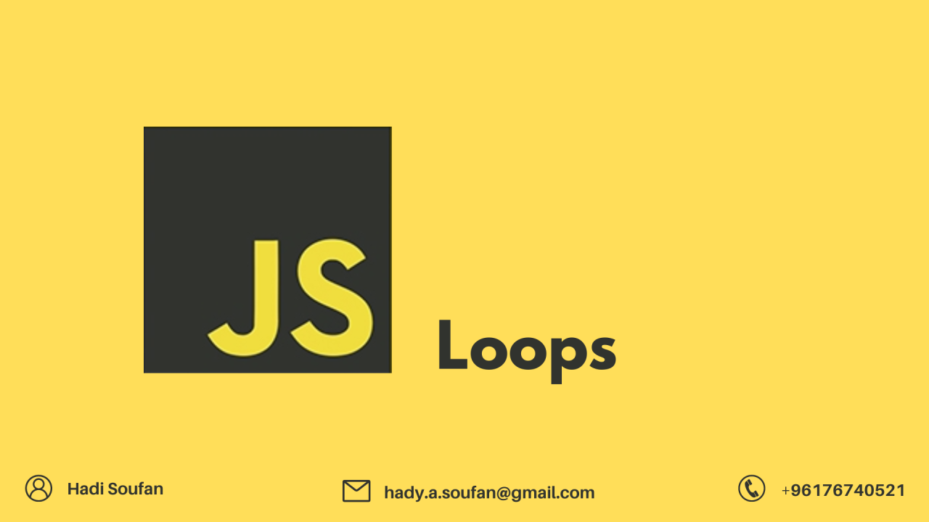

Slide 2
What we Cover Today:
01
02
03
04
05
Loop
For Loop
While Loop
Do while Loop
Exercise

Slide 3
Loop
Loop is a control structure that allows you to repeat a block of code multiple times based on a certain condition or a set of conditions.
There are Three main types of loops in JavaScript:
For Loop
While Loop
Do-while Loop

Slide 4
Loop
iteration means how many times the loop repeats the code inside it.
For Loop
A for loop is used when the number of iterations is known beforehand. It repeats a block of code a fixed number of times.
For loop is the must commonly used loop, it is used when we want to perform initialization, Condition and updating (increment | decrement)
SYNTAX
For (initialization; condition; updating) {
block of code
}

Slide 5
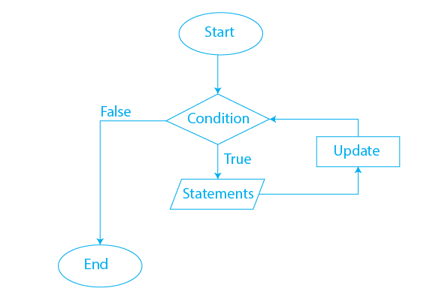
Loop
For Loop
Initialization: This step initializes a loop control variable. It is executed only once at the beginning of the loop.
Condition: The loop runs as long as the condition evaluates to true.
Update: This step updates the loop control variable after each iteration

Slide 6
Loop
For Loop
Example
for (let i = 0; i < 5; i++) {
console.log(`The Number is ${i}`);
} Output:
The Number is 0
The Number is 1
The Number is 2
The Number is 3
The Number is 4

Slide 7
Loop
For Loop
Example 2: Loop On Sequences
Let Boys = [“Ahmed”, “Ali”, “Anas”, “Ciise”, “Muuse”];
console.log(Boys[0]);
console.log(Boys[1]);
console.log(Boys[2]);
console.log(Boys[3]);
console.log(Boys[4]);

Slide 8
Loop
For Loop
Example 2: Loop On Sequences (Solution)
Let Boys = [“Ahmed”, “Ali”, “Anas”, “Ciise”, “Muuse”];
for (let i = 0; i < Boys.length; i++) {
console.log(Boys[i]);
}

Slide 9
Loop
For Loop
Example 3: Filter Strings in Array
    let arr = [1, 2, "Ahmed", "Ali", 5, "Anas", "Ciise"];
    let onlyNames = [];
    for (let i = 0; i < arr.length; i++) {
    if (typeof arr[i] === "string") {
    onlyNames.push(arr[i]);
    }
    }
    console.log(onlyNames); // ["Ahmed", "Ali“, "Anas", "Ciise"];

Slide 10
Loop
While Loop
While loop is a pre-test loop, it is used when we don't know how many times the loop will run, but it depends on a condition being true.
SYNTAX
while (condition) {
block of code
}

Slide 11
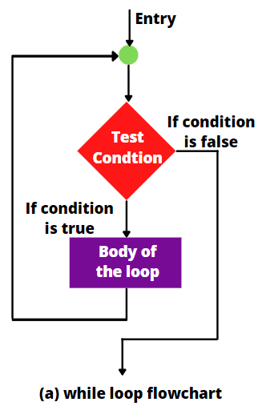
Loop
While Loop
Example:
let i = 0
while (i < 10) {
console.log(i);
i++;
}
Note: If you forget to increase the variable used in the condition, the loop will never end. This will crash your browser.

Slide 12
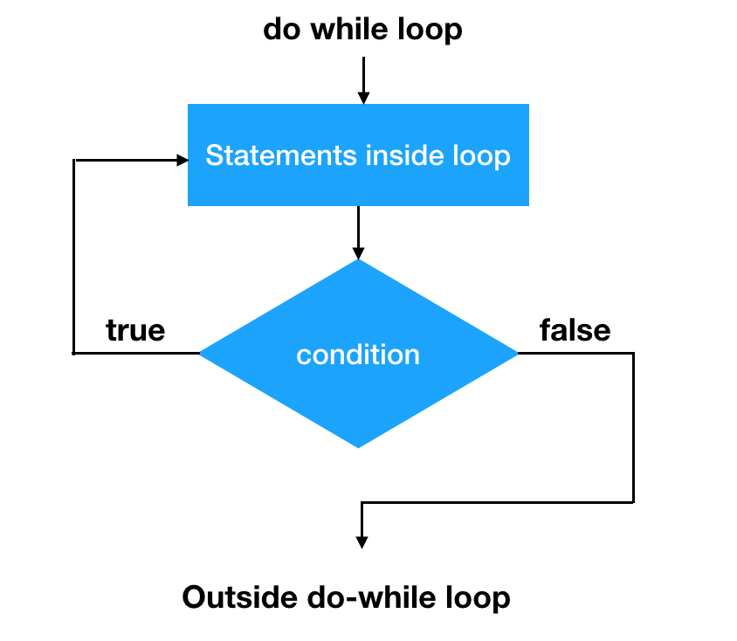
Loop
Do-While Loop
Do-while loop is a way to repeat some code in Java. The code will always run at least once, no matter what. After the code runs, it checks if a condition is true. If the condition is true, the code runs again. If the condition is false, the loop stops. It is also known as exit control loop.
SYNTAX
do {
block of code
} while(condition);

Slide 13
Loop
The number is 0
The number is 1
The number is 2
The number is 3
The number is 4
The number is 5
The number is 6
The number is 7
The number is 8
The number is 9
Do-While Loop
Example:
let i = 0;
do {
console.log(``The number is ${i}`);
i++
} while(i < 10);

